Slide 1
Streetcar delays prediction using TTC streetcar delay data
Murad Mebrahtu 100043387
18/04/2021

Slide 2
Background
System:
The Toronto streetcar system is a network of ten streetcar routes in Toronto, Ontario, Canada, operated by the Toronto Transit Commission(TTC).
As many transportation systems, this streetcar system has the occasional delays in its routes.
Goal:
The goal of this project is to predict and possibly avoid the delay in the streetcar system.
Data:
The data that is going to be used in this project has been collected by the TTC since 2014.

Slide 3
Data
The training data was collected over 6 years from 2014-2020.
Features: contains 10 features as shown below.
The data is collected from 6 excel sheets for each year. Some years have additional features.
There is inconsistency in the number of features (incident id found in some entries).
Moreover, the naming of the features is not consistent over the whole data.
This means the data requires data pre-processing to clean the data before assuming all the data for training.
Report Date | Route | Time | Day | Location | Incident | Min Delay | Min Gap | Direction | Vehicle

Slide 4
Data Processing
First let's remove data that is not known at the prediction time. Those are the features that cause data leakage. Min Gap, Incident.
We want to predict the delay or if there is delay, before any incident happens, therefore incident type and Id are not used for training. If we wish to predict delay after a specific incident happens then we can use the incident data as a feature. Similarly, Min Gap is not known until after incident occurs and delay is caused, therefore it is removed as well. Those two are the main causes of data leakage.
Moreover, location is also removed at this stage, since the given location is related to the incident.
Removed features not found in most entries such as incident id, which can be derived later if necessary.

Slide 5
…
Concatenated data frames created from data of each year to create a unified data for training.
Dropped rows with null entry in any of the columns
Divided the report date into date, time and year
Added a derived column called day [Monday, Tuesday...Sunday]
Hours were changed into categorical data [ 0-23]
Direction: is a categorical data containing {eb,sb,wb,nb,ew} which indicate where the streetcar is headed.
Day and Direction are not numeric data, therefore they are encoded and changed into numeric data

Slide 6
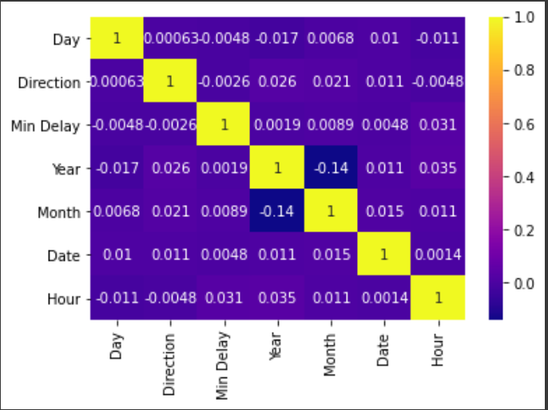
More Data Cleaning
Removed data entries that contain invalid direction results.
Route: is the route number of the streetcar.
Removed entries with invalid route values.
Results:
70,642 entries
8 features including Delay
The correlation between the features ->

Slide 7
Linear Regression
After cleaning the data, as a test run linear regression model was trained from the data.
Training Parameters
Predictors: 'Route’, 'Hour’, 'Month’, 'Day’, 'Direction’
Target: Delay
Polynomial degree 4
Result
Mean absolute error = 8.94 Mean squared error = 574.79
Median absolute error = 5.9 Explain variance score = 0.01 R2 score = 0.01
Notes:
.

Slide 8
Observation
'''From the results of the above model, it can be observed that it is unrealistic and inaccurate to predict
the delay time expected just from the route, date, direction and time.
Moreover, as mentioned above, the model uses data that contains delays only, so it can not predict no
delay, therefore, it is not the best application of the data for prediction.
The best use of the given data is to predict if there is going to be a delay or not (binary classification)
on a specific route going to a specific direction at a specific time.
To do this however we will need to add the missing information of no delay times (when the Streetcar arrived on time). This means adding each hour of everyday from 2014 until August 2020 of each route going to each direction.
If an entry exists in the delay data already then, its output is 1 which means delay, if a certain combination of the input features, however, is not on the delay data entries, then it is added to the training data with output of 0.
By doing this we train the model when to expect delays and when not to. In the next section, the training data containing all the mentioned data will be prepared and used to train different classification models.

Slide 9
Deriving New Data
As mentioned all the timeslots, directions, routes should be considered.
However not all combinations are valid, example some routes are south /north bound, and others are east/west bound, therefore there should be two separate combinatorial cases.
In terms of working hours, i am assuming all of them work 24/7
Moreover, assigning day name is also important, On the 1st of January it was Wednesday, so it should iterate through the days starting from Wednesday.
When deriving the data, special cases such as leap years and number of days in month where all considered.
The result of derived data contains The total number of training data is 1,615,488.
The only thing left is to add the target feature, delay from the streetcar data given , we have around 70,642 delay records
For the 70,642 cases, the delay is 1 (which means there is delay) for the rest, delay is zero
To add the delay variable, at first all rows will have no delay (0),then if a specific date and time is found in the delay data frame, its delay will be updated by 1

Slide 10
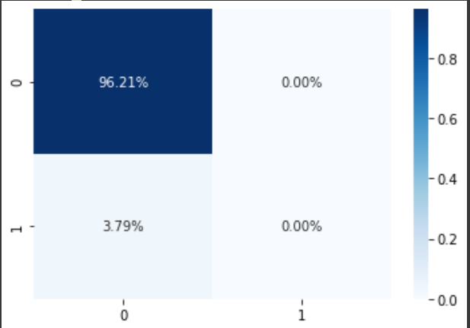
Data Imbalance
Note: there is huge class imbalance in delay and non delay. Just to see the effect of the imbalance the data was used as it is for training.
After using logistic regression to predict delay or not delay,
the results were the following:
Model accuracy:96.21% Model precision:0.00%
Model Recall:0.00% Model F1_score:0.00%
Observation:
From the prediction results we can see that the model is predicting everything as 0 (no delay)
Since there is huge class imbalance (1:23), we get high accuracy (but zero recall and f1_score) even by predicting all as no delay to tackle this issue we will use oversampling (Random oversampling involves randomly duplicating examples from the minority class and adding them to the training dataset.)
After oversampling, the total training data will contain around the same data entries from both classes

Slide 11
Sampling
Three sampling techniques were used to solve the problem of class imbalance; oversampling , under sampling and combination of both. After sampling, the new data was used to train a logistic regression model to see how it improves the model output.
training data : before : 1138398 test data size before : 487886
Oversampling Result
training data : 2190506 test: 938824
Model performance: accuracy:63.47% precision:58.06% Recall:96.97% F1_score:72.63%
Under sampling Result
training data : 86290 test: 36948
Model performance: accuracy:63.20% precision:57.85% Recall:97.30% F1_score:72.56%
Combination sampling Result
training data : 86290 test: 36948
Model performance: accuracy :63.57% precision:58.11% Recall:97.15% F1_score:72.72%
For the rest of the models tested, the last sampling method
(combination of over sampling and under sampling ) is used for training other models.

Slide 12
Training
After cleaning the data and solving the imbalance problem, it is time for training different models.
PARAMETERS:
Training Data: 86290 entries Testing Data: 36948 entries
Predictors: Route, Direction, Day, Year, Month, Date, Hour
Target: Delay { 0,1}
Models:
Logistic regression,
Random Forest
KNN
Decision Tree
XG Boost
Gradient boost
Ada boosting

Slide 13
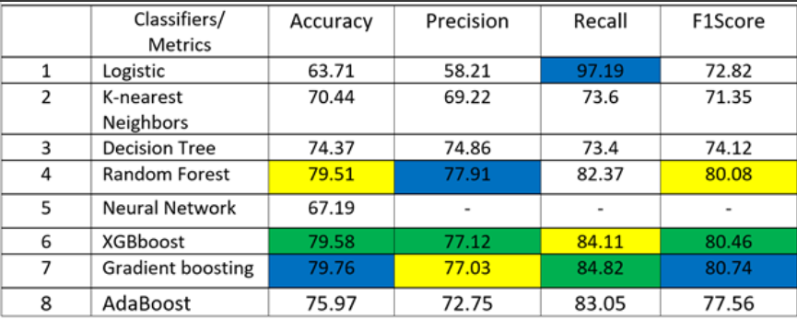
Results
After trying 8 classification types with total of 11 models the following result were obtained:
NB: For sampling, a combination of both over and under sampling was used. The result is summarized in the table below.

Slide 14
Results…
As shown in the table, the models were evaluated on four metrics; accuracy, precision, recall and F1 score. The blue color shows the highest score in specific metric. e.g.: logistic regression showed the highest recall rate; therefore, its row is colored blue. Similarly green and yellow represent the second and third highest values respectively.
As can be seen from the table, except neural networks and logistic regression, all models scored above 70% in all metrices. Especially the boosting classifiers showed well balanced result over all metrics.
Based on the overall performance XGboost, Gradient boosting and Random Forest are the best models. At different instances , their result was close to each other and always around 80% in all metrics. Logistic regression although having extremely high recall, its accuracy is very low in comparison.to others.

Slide 15
Fine Tuning…
Now that the most effective models have been selected. It is time to fine tune the system.
The tree best models are Random Forest, gradient boost and xgboost. However, since the 3 models
have similar recall and precision output it would be wise to consider KNN as additional model if stacked classifier is to be created.
Before Stacking the classifiers, however, each model will be fine tunned to find the best results.
The main concept of fine tunning is that different combinations of hyperparameters are tested.
However, while the system accuracy improves, the model is very likely to overfit since it is being trained
to improve the accuracy of training and testing data.
The solution to this issue is to use cross-validation, where the data is divided into training, validation
and testing.

Slide 16
Fine Tuning…RandomForest
Random forest classifier has many parameter that can be tuned those include number of estimators, number of features, minimum sample split and many others.
Although it is impossible to test all the combinations, it possible to create an array of different setting combinations and randomly testing hyperparameters.
In the next section different ranges of possible settings are set for different parameters.
RandomForest fine tuning requires extensive computing power, for this reason only few combinations
were tested, since the accuracy of the model is already good. It will be useful when used in stacked classifier.
Improvements:
NEW: accuracy:80.51% precision:77.89% Recall:85.22% F1_score:81.39%
OLD: accuracy :79.64 precision: 78.01 recall: 82.54 f1_score: 80.21

Slide 17
Fine Tuning…XGBoost
There are many parameters that can be tuned for the XGboost model.since it is impossible to test all combinations of hyperparameters, i will focus on the main parameters such as number of boosting tress, max_depth,min_child_weight,subsample,colsample_bytree and learning rate
One way to tune those hyperparameters is to use grid search over different combination of parameters but this will require extensive computing power and time that is beyond this project but tuning few parameters one by one is the best choice.
The parameters mentioned above were therefore tunned one by one by keeping the rest of parameters constant.
Improvements:
NEW: accuracy:80.32% Precision:77.08% Recall:86.29% F1_score:81.43%
OLD: accuracy: 79.30 Precision: 76.44 Recall: 84.70 F1_score: 80.3

Slide 18
Fine Tuning…Gradientboost
Similar to Xgboost, here the following parameters were fine tunned:
n_estimators -> range tested(100,700,step=100) : best: 200
max_depth ->range(5,12, step= 2) best:7
min_samples_split -> range(300,1100, step= 200) best: 300
min_samples_leaf -> range(30,61,step=10) best:60
max_features -> range(1,8,step=1) best:5
Subsample -> [0.7,0.75,0.8,0.85,0.9] best:0.8
Improvements:
New: accuracy:80.87% Precision:77.60% Recall:86.80% F1_score:81.94%
OLD: accuracy: 79.46, Precision: 76.97 Recall: 84.07 F1_score: 80.36

Slide 19
Final Model
After fine tuning the model. Each model improved slightly but to further improve the performance, the three models can be integrated (stacked ) to create a new stacked model.
Moreover, voting classifier was also tested if it could enhance the accuracy
Random Forest: accuracy:80.51% Precision:77.89% Recall:85.22% F1_score:81.39%
XG boost : accuracy:80.32% Precision:77.08% Recall:86.29% F1_score:81.43%
Gradient Boost: accuracy:80.87% Precision:77.60% Recall:86.80% F1_score:81.94%
Stacked Classifier: accuracy:80.80% Precision:77.83% Recall:86.16% F1_score:81.78%
Voting Classifier: accuracy:80.74% Precision:77.59% Recall:86.45% F1_score:81.78%
BEST:
Finally, the selected model is Gradient Boosting with accuracy of 80.87% and F1_score of 81.94%.

